Slide 1
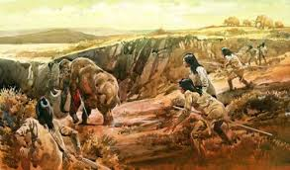
PALEOLITHIC ERA Old Stone Age 75,000-15,000 YEARS AGO

Slide 2
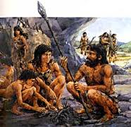
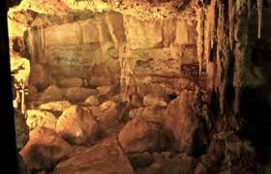
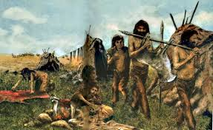
People lived in small bands/groups and lived in caves. Pg.54
Bands/groups usually had about 20-30
members

Slide 3
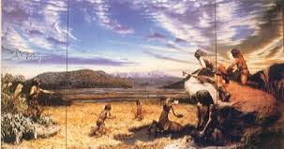
Hunter-gatherers/Nomadic Societies
Nomads are people who regularly move from place to place to search for food.
They often moved around to survive.
They had to learn which animals to hunt and which plants to eat.
Pg.54-55

Slide 4
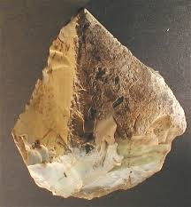
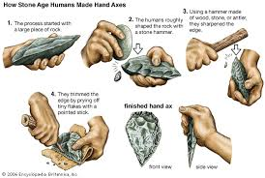
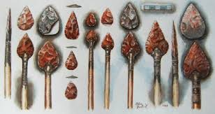
Nomadic people made simple stone tools. Pg.56
Hand-axe
Chopper
This made killing large animals
easier.
Spear

Slide 5
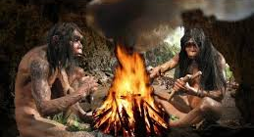
*Fire was first used when found from lightning. * They had not learned to make fire but could control it. * They used fire for warmth, light, to scare away wild animals, and eventually to cook.

Slide 6
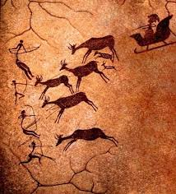
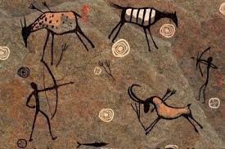
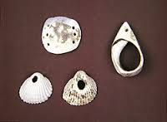
Nomads lived in caves where they produced cave art. They also produced used shells to make jewelry. Pg.58-59

Slide 7
Review Questions
1. Why were Paleolithic people considered to be nomadic?
2. How did spears make the peoples’ lives easier?
3. These people knew how to create fire. True/False

Slide 8
Design Your Own Cave Art
Crumble up a piece of paper and open it up.
Using your knowledge of cave art and what you learned about the Paleolithic Era, design a scene that depicts a day in the life a a Paleolithic human.
After you design your drawing, write a description of your cave art explaining what you drew.

