Slide 1
MESOLITHIC AGE
AKA MIDDLE STONE AGE
15,000-10,000 years ago. Around the time of the Ice Age

Slide 2
What do you remember about the movie Ice Age?
Watch Ice Age Brain Pop

Slide 3
Design a web in notebook as below. Read p. 60-61. Share ideas with group when done reading.

Slide 4

Ice Age
15,000- 10,000 years ago.
Ice Age/ Mesolithic Era

Slide 5
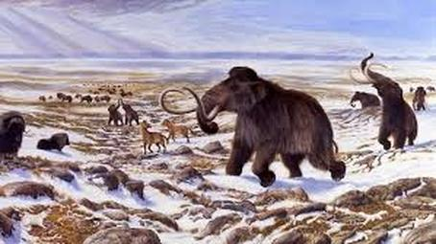
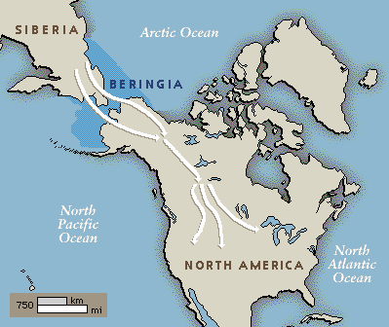
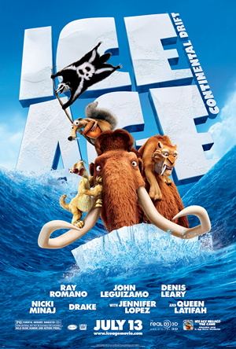
*A land bridge once connected Asia and North America
* It allowed people to migrate to new land. areas. P. 60-61

Slide 6
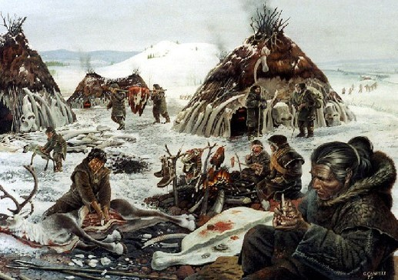
Human migrations made people have to change their type of clothing and shelter.P. 56-57

Slide 7
Interactive Migration Map
https://www.eduplace.com/kids/socsci/ca/books/bkf3/imaps/AC_02_047_migration/AC_02_047_migration.html

Slide 8
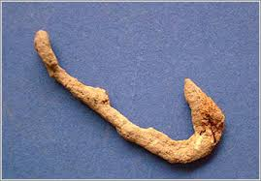
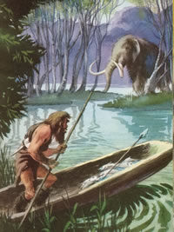
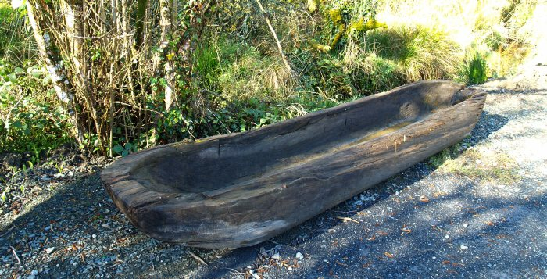
*Characteristics of the period were hunting and fishing settlements along rivers and on lakeshores
*Fish and mollusks were eaten and was a good source of fat. P. 54
This led to the invention of the fish hook and canoe

Slide 9
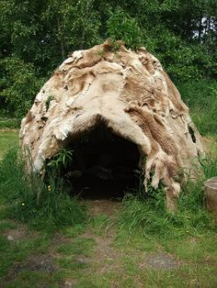
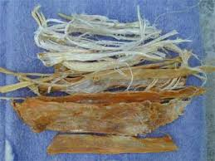
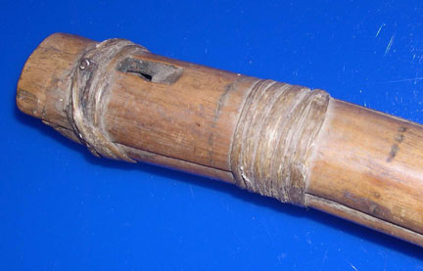
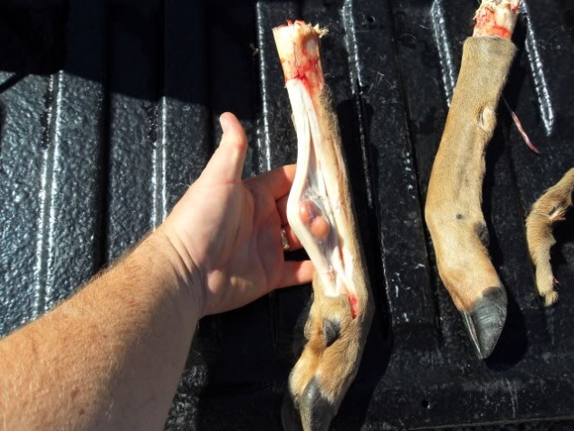
Evidence of sewing hides together using awls and sinew P. 56-57
Shelters were made of flexible saplings and animal hides or turf sods
Sinew is made from the ligaments and tendons of an animal's body. It is very strong and is an excellent material for thread, bindings, and bowstrings.

Slide 10
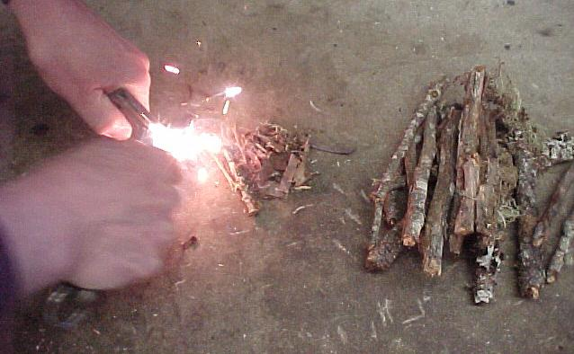
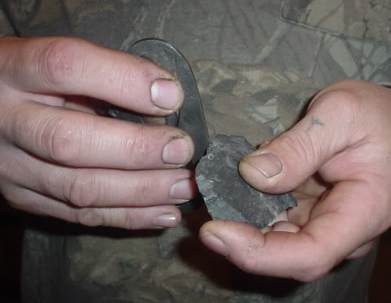
*Fire was started using a stone and a flint blade and beating them together.
*These stones were called microliths. P. 56
When they beat the stones together, this caused _________ which made the fire.

Slide 11
Watch how to make fire the Mesolithic way
https://www.youtube.com/watch?v=G5vnLg9uZwc

Slide 12
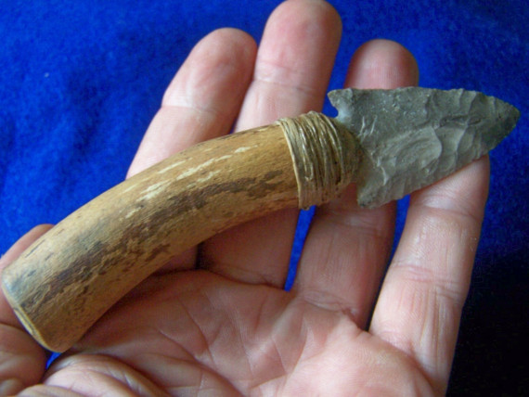
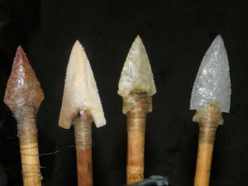
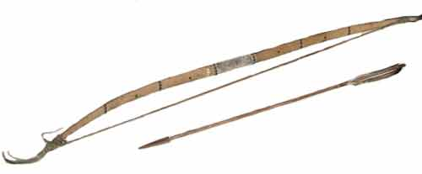
*Flint was made into various shapes called ‘microliths’. *There is archaeological evidence to show that these blades were used to provide the tips and barbs of arrows
The bow and arrow was invented during this age.

Slide 13
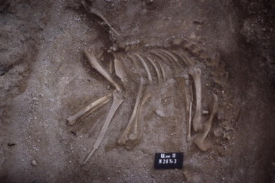
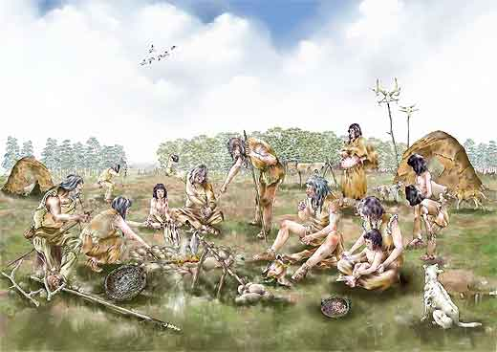
*Dogs became domesticated in this age. *Archaeologists know this because they found the remains of a dog buried in its own grave. P. 62

Slide 14
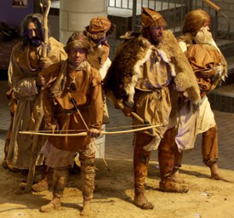
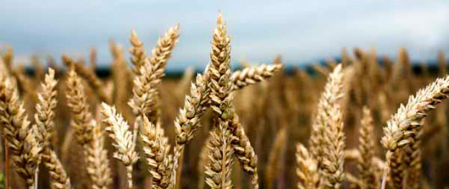
As the Ice Age ended:
New food sources like barely and wheat began to emerge
Animal skins were used as clothing.

Slide 15
The shift from hunting and gathering to farming makes the transition in to the Neolithic Age.
This shift is one of the biggest achievements in the world.
The Agricultural Revolution!

Slide 16
Small group I have who has cards
http://misscollishawsocialstudies6.cmswiki.wikispaces.net/Unit+6+Early+Humans

Slide 17
Ice age map reading worksheet
http://misscollishawsocialstudies6.cmswiki.wikispaces.net/Unit+6+Early+Humans

