Slide 1
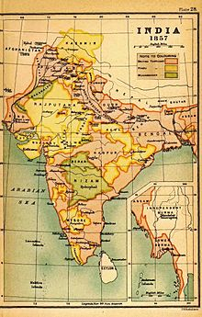
Unit 4 India Visual Vocabulary

Slide 2
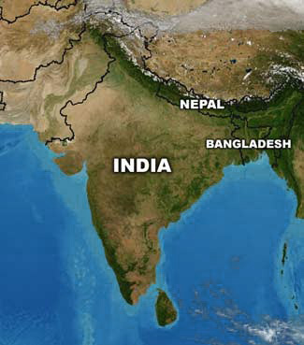
Subcontinent
A large landmass that is smaller than a continent

Slide 3
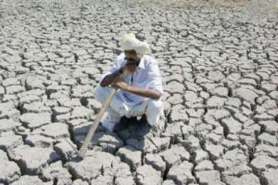
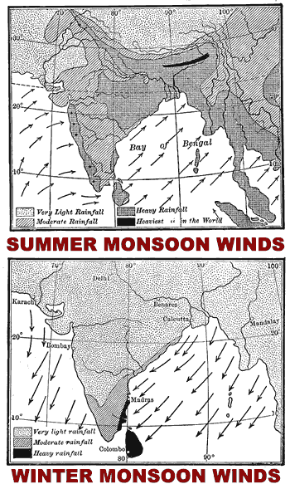
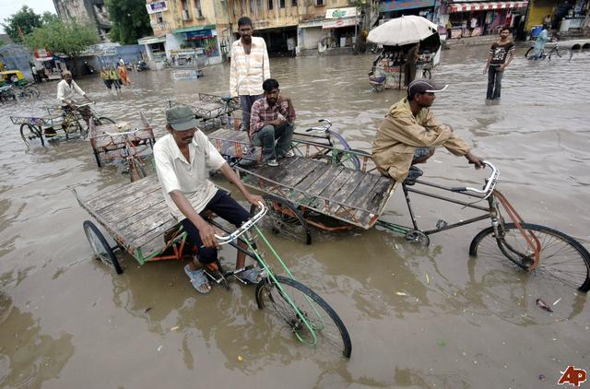
Monsoons
Seasonal wind patterns that cause wet and dry seasons

Slide 4
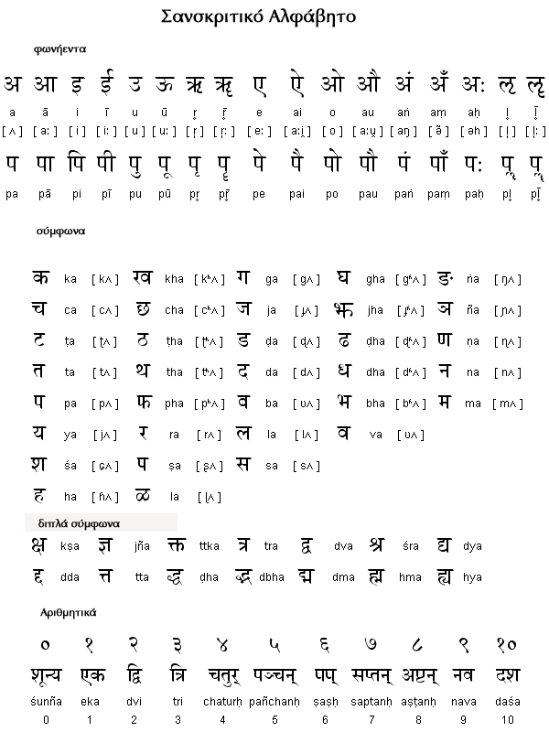
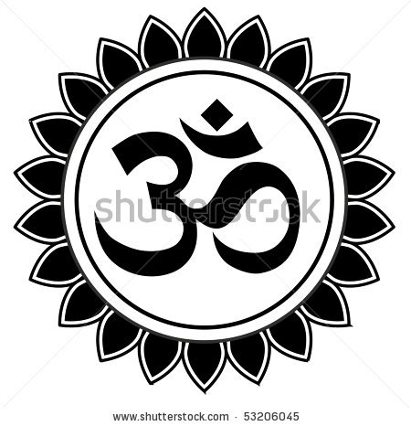
Sanskrit
The most important language of Ancient India

Slide 5
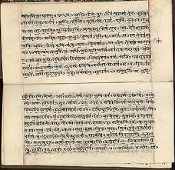
Vedas
Ancient sacred writings of India.

Slide 6
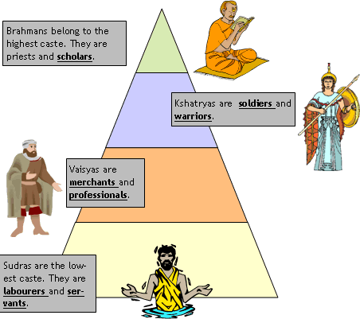
Caste System
Divided Indian society into groups based on a person’s birth, wealth, or occupation.

Slide 7
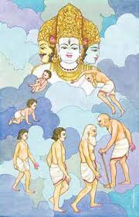
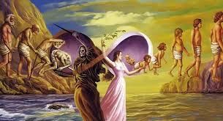
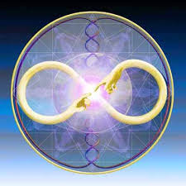
reincarnation
The rebirth of the soul.

Slide 8
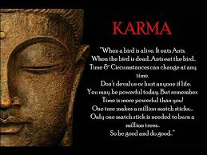
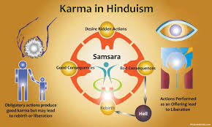
karma
A force that decides the form that people will be reborn into in their next lives.

Slide 9
Dalits Political name of caste considered “untouchable”.

Slide 10
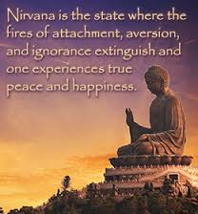
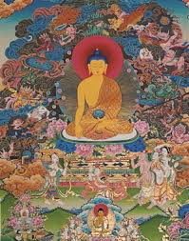
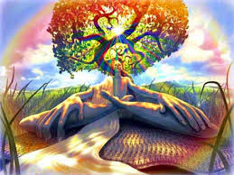
nirvana
In Buddhism, a state of perfect happiness and peace.

Slide 11
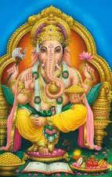
Brahmanism
The religion brought by Aryans that became the basis of Hinduism religion.

Slide 12
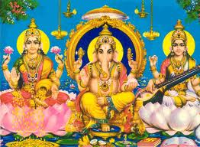
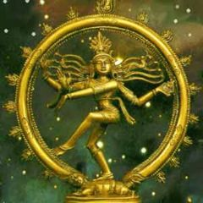
Hinduism
The largest religion in India today. 1st religion in India. Focus on 4 Noble Truths, Karma, and Reincarnation.

Slide 13
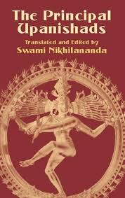
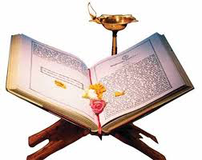
Upanishads
A collection of texts which contain some of the central concepts of Hinduism.

Slide 14
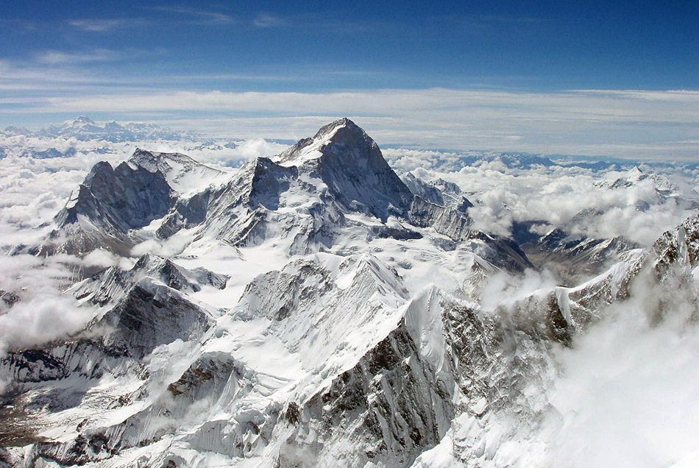
Himalayas
The planet's tallest mountain range, including the highest, Mount Everest. Provides a natural border for India.

Slide 15
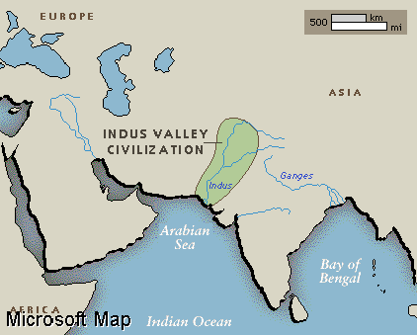
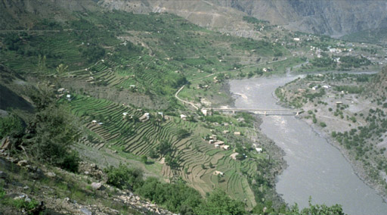
Indus and Ganges Rivers
Two of the most important geographic features in India, providing water sources and creating fertile land.

Slide 16
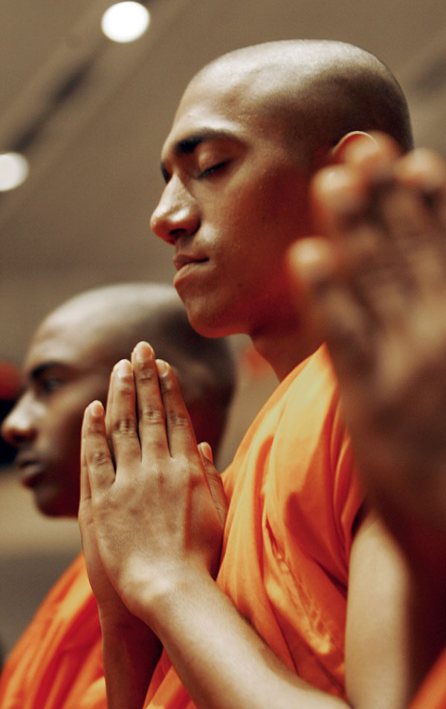
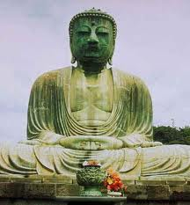
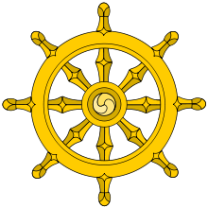
Buddhism
A religion based on the teaching of Buddha. Centered on the ideas of the 8 Fold Path.

Slide 17
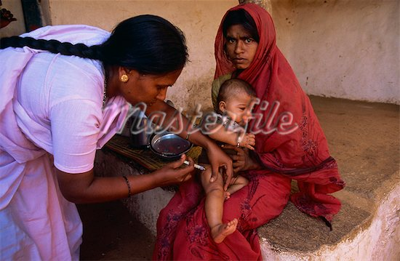
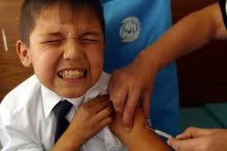
Inoculation
Injecting a person with a small dose of a virus to help him or her build up defenses to a disease.

